Slide 1

CAF Compliance
Compliance attestation, delivered where the business already works
Salesforce engagement layer · ServiceNow compliance engine
Proof of concept — decision brief
Confidential — prepared by Reyan Technologies. Not for redistribution without written consent.

Slide 2
The engine works. The engagement doesn't.
CAF governs recurring compliance of critical business applications — backup and restore, disaster recovery, RTO and RPO, high availability.
The control framework is sound. Controls, recurrence, overdue detection, approvals and the audit trail all run today in ServiceNow. Nothing about that needs to change.
The cost scales with participation, not with work. Every application owner and delegate approver who touches CAF needs a ServiceNow fulfiller licence — so the more people we ask to attest, the more it costs to let them.
Adoption is the named risk. Low portal adoption is already on the risk register. “I'm not logging into ServiceNow for this” is the whole problem in one sentence, and no amount of engine work fixes it.
Compliance fails at the last mile — not because the rules are wrong, but because the people who must attest to them don't live in the tool that asks.
Confidential — prepared by Reyan Technologies. Not for redistribution without written consent.
2

Slide 3
One product. Two platforms. One system of record.
The state machine and the system of record stay in ServiceNow. Salesforce holds a mirror, never a second opinion.
ServiceNow owns
Salesforce owns
· Controls, relationships, task templates
· Request and task records — the system of record
· Recurrence, next due date, renewal
· Scheduled jobs and overdue detection
· Approvals engine and attestation outcome
· Roles, ACLs, row-level security
· The business-facing user interface
· Application-owner portfolio view
· Drill-in to request and task detail
· Evidence upload, held in Salesforce Files
· Attestation submission
· The CAF dashboard, as a Lightning component
Zero change to the 24 business rules, the recurrence logic or the security model. The engine is untouched, so delivery risk stays low.
Confidential — prepared by Reyan Technologies. Not for redistribution without written consent.
2

Slide 4
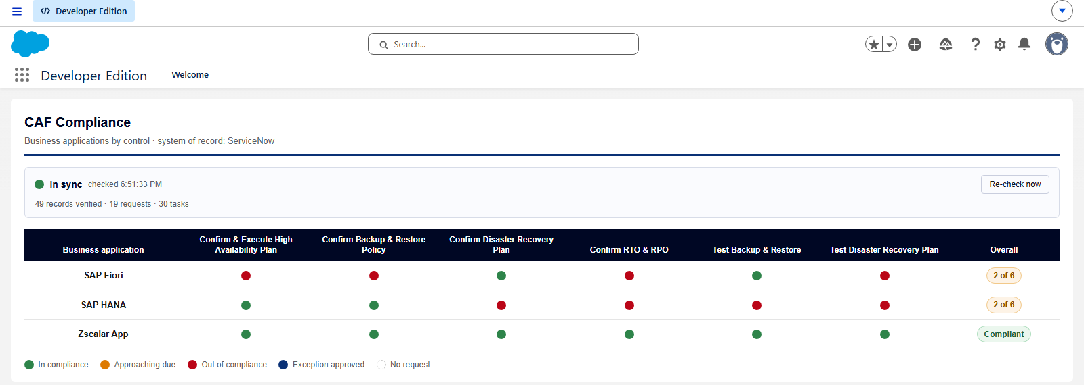
What an application owner sees
The CAF dashboard, inside Salesforce. Applications down the side, controls across the top — and the controls are drawn from the data, not from a fixed list.
Live capture from the proof-of-concept org. Each dot is one control on one application; the Overall column is the verdict the business cares about. An application reads Compliant only when every one of its controls does.
Confidential — prepared by Reyan Technologies. Not for redistribution without written consent.
2

Slide 5
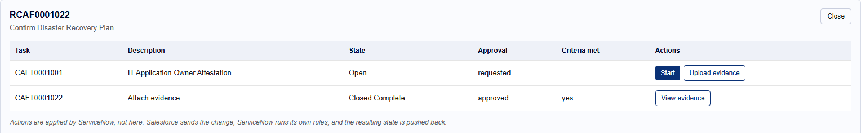
From portfolio to the task in two clicks
Selecting a dot opens the request behind it and the tasks that make it up.
Every action is a ServiceNow action. Salesforce sends the change, ServiceNow runs its own rules, and the resulting state comes back. The business user never sees the seam.
The available actions follow the state. An open task offers Start and Upload evidence; one in progress offers Attest; a closed one offers only its evidence — which is exactly what an audit asks for.
Confidential — prepared by Reyan Technologies. Not for redistribution without written consent.
2

Slide 6
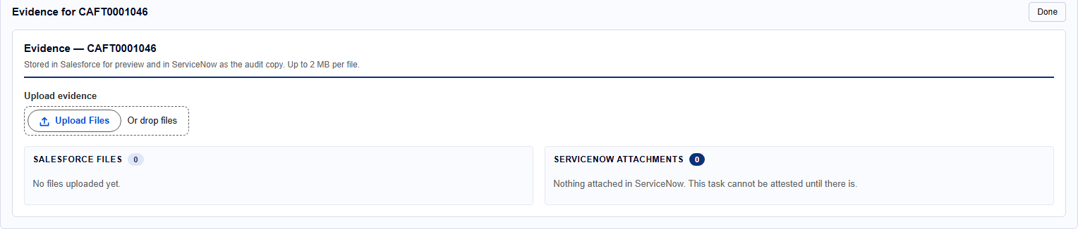
Evidence is gathered by the owner
Upload the proof against the task it belongs to, without leaving Salesforce.
Two copies, deliberately. Salesforce keeps the file so it previews and downloads natively; ServiceNow keeps the copy an auditor is entitled to. Both are listed side by side, so a failed transfer is visible rather than assumed.
Confidential — prepared by Reyan Technologies. Not for redistribution without written consent.
2

Slide 7
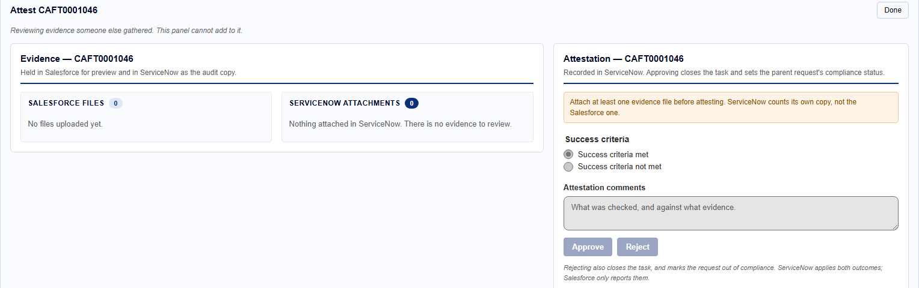
Evidence is judged by someone else
The approver sees the evidence read-only beside the attestation — enough to judge it, with no ability to add to it.
Gathering evidence and attesting to it are separate panels because they are separate jobs. An attestation with no evidence behind it is refused outright.
Confidential — prepared by Reyan Technologies. Not for redistribution without written consent.
2

Slide 8
A mirror is only useful if something checks it
Sync Health compares every mirrored record against ServiceNow and reports the difference.
It really goes and looks. The check is a live call to ServiceNow on every run, not a cached figure — so a green strip is evidence, not decoration.
Detection is automatic; repair never is. Drift is surfaced next to a Re-sync button that a person presses. Unattended repair can turn a Salesforce problem into a ServiceNow one.
Repair only ever flows one way. ServiceNow overwrites Salesforce. A mirror that disagrees with the system of record is stale by definition, so there is nothing to negotiate.
Confidential — prepared by Reyan Technologies. Not for redistribution without written consent.
2

Slide 9
How we know it works
A written test pack, executed by an automated harness against both live platforms.
130
31
49
6
test cases specified
executed to date
records verified in sync
failing cases, 4 distinct defects
Two proofs for every case. Each case records what the screen showed and what the underlying record holds. A green confirmation message proves a form submitted, not that the rule behind it ran — and this architecture's characteristic failure is the two platforms quietly disagreeing, which a one-sided check cannot see.
Nothing is retyped between specification and result. The evidence documents are generated from the test definitions and the recorded run, so a document cannot claim an expected result the specification does not contain.
The 99 unexecuted cases are held by decision, not by capability. The harness covers all of them. Each one writes to a live platform, and those runs are being held for sign-off — several consume records that cannot be reset.
Confidential — prepared by Reyan Technologies. Not for redistribution without written consent.
2

Slide 10
What has been run, and what it returned
Every case below was executed against the live proof-of-concept environment.
Area
Cases
Result
What it covered
Salesforce user interface
7
7 pass
Dashboard, drill-in, evidence and attestation panels, sync strip
Integration, record level
17
13 pass · 3 fail · 1 blocked
Mirror integrity, idempotency, echo-loop guard, API budget
ServiceNow engine and portal
7
4 pass · 3 fail
Data model, choice sets, compliance roll-up, approvals
The six failures are one small set of defects, seen from both sides. None is a fault in the test harness, and none blocks the demonstration. The material one is on the next slide.
Start, Approve and Reject were read as controls and deliberately not clicked. Each closes a task irreversibly in the system of record.
Confidential — prepared by Reyan Technologies. Not for redistribution without written consent.
2

Slide 11
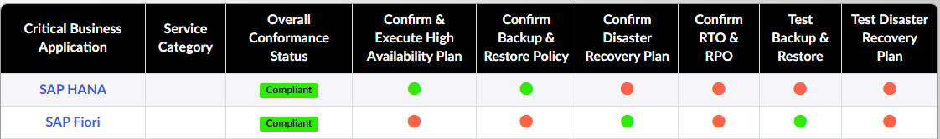
The finding that matters
The two platforms disagree about which applications are compliant — and Salesforce is the one that has it right.
ServiceNow — reads Compliant for both
Salesforce — reads 2 of 6 for both
Same two applications, same control results — four of six out of compliance each. Salesforce computes the roll-up and is arithmetically right; the ServiceNow field is set by a rule that never checks sibling controls. One rule to fix, and the mirror needs no change.
Confidential — prepared by Reyan Technologies. Not for redistribution without written consent.
2

Slide 12
Where this stands
Proven and working
Not yet built
· Compliance dashboard in Salesforce, live against ServiceNow data
· 19 requests and 30 tasks mirrored, verified record by record
· Evidence upload, stored on both platforms
· Attestation end to end — approve, close, update compliance status
· Sync Health: drift detected, repaired, and confirmed clean
· The licence-free access surface — the point of the whole business case
· Automated test coverage on the Salesforce service classes
· A named approver on the record, rather than whoever pressed the button
· Queued delivery, so a ServiceNow outage doesn't surface to the user
· Production security model — deliberately out of scope for the proof of concept
The engagement layer is demonstrably real. What remains is the access surface that converts it into the licence saving, and the hardening any move toward production would require.
Confidential — prepared by Reyan Technologies. Not for redistribution without written consent.
2

Slide 13
What we're asking for
1
Fix the compliance roll-up rule.
One ServiceNow business rule. It makes both grids agree and removes the only defect a business user would actually notice.
2
Decide on the licence-free access surface.
Confirm the available Experience Cloud licence count, then approve building the site. Until this exists, the adoption and licensing argument is demonstrated but not delivered.
3
Release the remaining test cases to run.
99 specified cases are held pending approval to write to the live environment. The harness is built; what is needed is sign-off.
4
Fund the production-readiness work.
Automated test coverage, queued delivery, a named approver on the record, and the security model that was deliberately deferred.
The compliance engine does not change. Everything above is delivery around it.
Confidential — prepared by Reyan Technologies. Not for redistribution without written consent.
2

